Slide 1
Sprint C 2NA – Group 1
Group Members:
Diogo Sousa (1222132)
Filipe Teixeira (1171159)
João Silva (1960184)
Simão Gomes (1050347)

Slide 2

Table of Contents
Sprint Planning – Sprint C
Sprint Backlog – Sprint C
Burn Up
Sprint Review
Sprint Retrospective

Slide 3
Sprint Planning – Sprint C
Start Date: 22/05/2023 End Date: 18/06/2023
SPRINT BACKLOG
Number of stories | 19
Number of bugs | 2
Number of tasks | 19
Number of Management Tasks | 14
Number of team members | Planned: 5 Actual: 4

Slide 4
Sprint Backlog – Sprint C
Legenda: ->complete -> in progress -> in review
✓
●
●
EAPLI
SPRINT BACKLOG
US 1007 | As Manager, I want to enroll students in bulk by importing their data using a csv file (Sprint B)
US 1010 | As Teacher, I want to schedule a class (Sprint B)
US 3002 | As User, I want to create a board (Sprint B)
US 2004 | As a Student, I want to take an exam
US 2005 | As a Student, I want to view a list of my grades
US 2009 | As a Student, I want to take an automatic formative exam
US 4002 | As a User, I want to cancel a meeting
US 4003 | As a User, I want to accept or reject meeting request
US 4004 | As a User, I want to view a list of participants in my meeting and their status (accept or reject)
STATUS
✓
✓
✓
✓
✓
✓
✓
✓
✓

Slide 5
Sprint Backlog – Sprint C
EAPLI
STATUS
SPRINT BACKLOG
US 2006 | As a Teacher, I want to view a list of the grades of exams of my courses
✓
LPROG
SPRINT BACKLOG
US 2008 | As Teacher, I want to create/update automatic formative exams (Sprint B)
US 2004 | As a Student, I want to take an exam
US 2009 | As a Student, I want to take an automatic formative exam
✓
✓
✓
RCOMP
SPRINT BACKLOG
US 3001 | As Project Manager, I want the team to prepare the communication infrastructure for the Shared Boards and the deployment of the solution (Sprint B)
US 3005 | As User, I want to view, in real-time, the updates in the shared boards
✓
●

Slide 6
Sprint Backlog – Sprint C
SCOMP
SPRINT BACKLOG
US 3004 | As User, I want to share a board
US 3005 | As User, I want to view, in real-time, the updates in the shared boards
US 3006 | As User, I want to create a post-it on a board
US 3007 | As User, I want to change a post-it
US 3008 | As User, I want to undo the last change in a post-it
US 3009 | As User, I want to view the history of updates on a board
US 3010 | As User, I want to archive a board I own
STATUS
✓
●
✓
✓
✓
●
✓

Slide 7
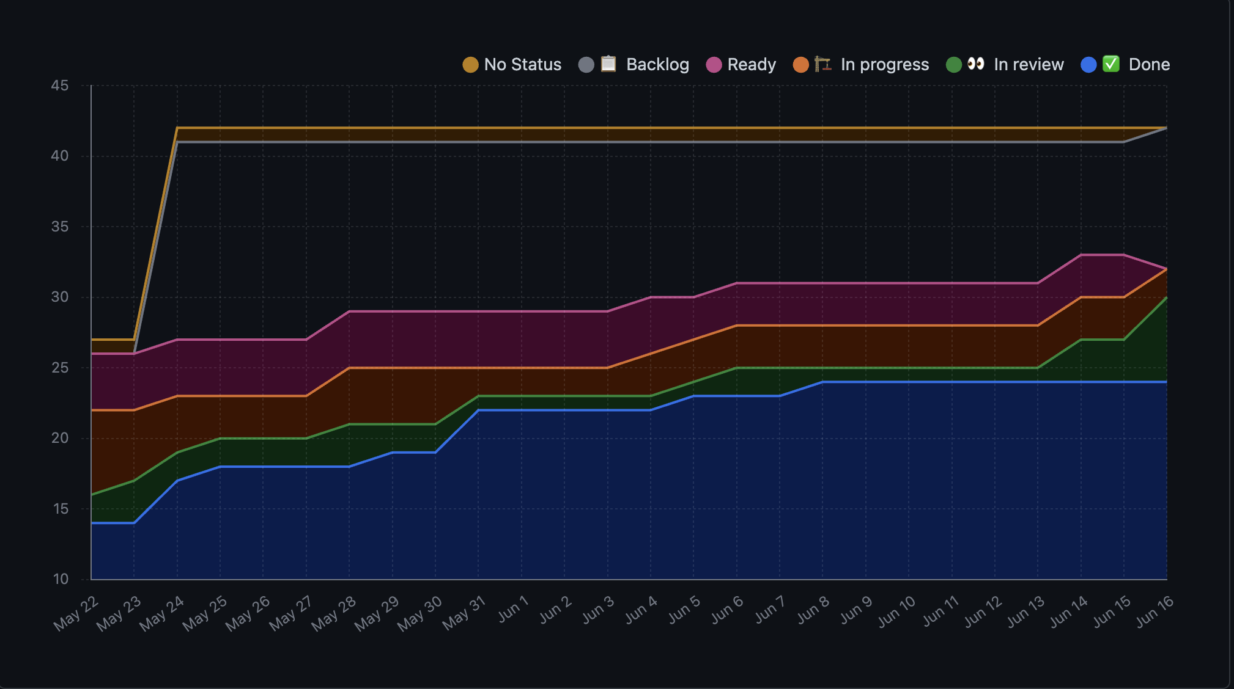
Burn Up

Slide 8
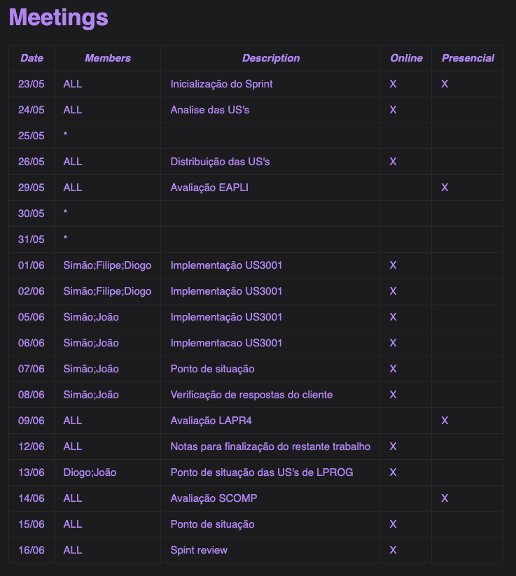
Daily Meetings

Slide 9
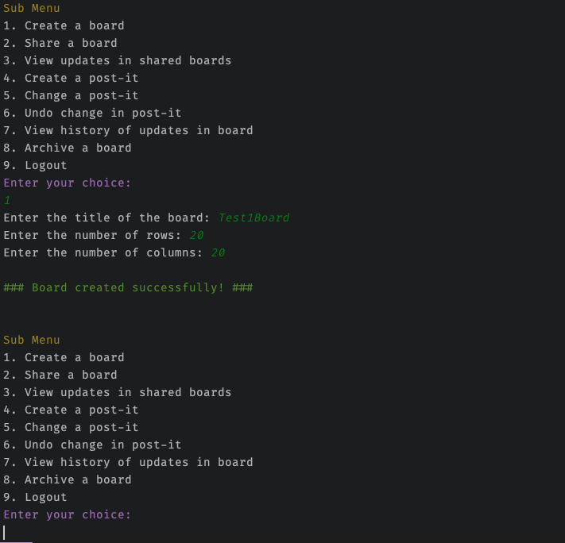
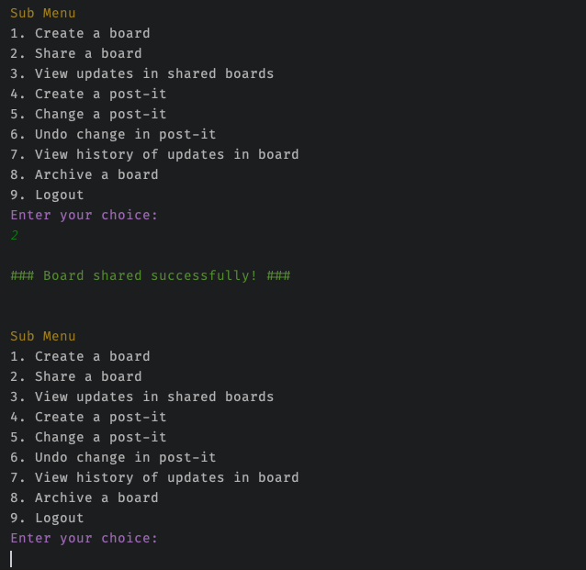
Sprint Review
EAPLI
Date: 18/06/2023
Demonstration:

Slide 10
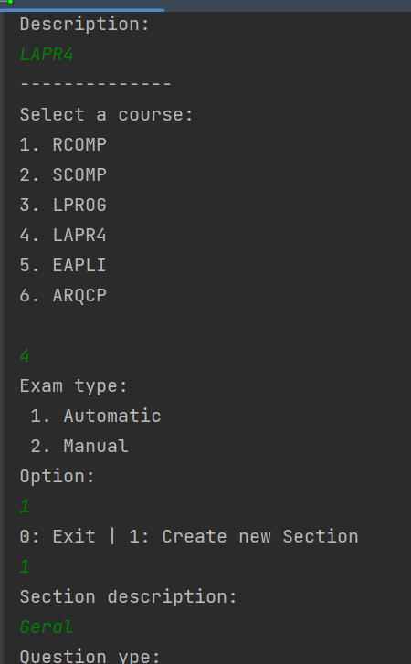
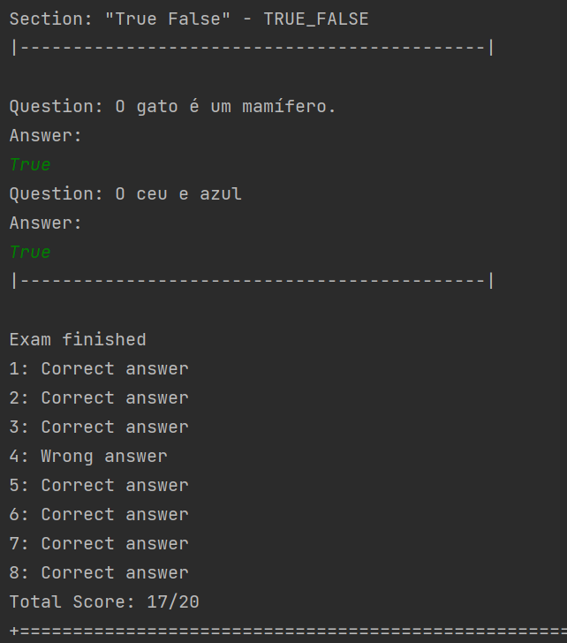
Sprint Review
LPROG
Date: 18/06/2023
Demonstration:

Slide 11
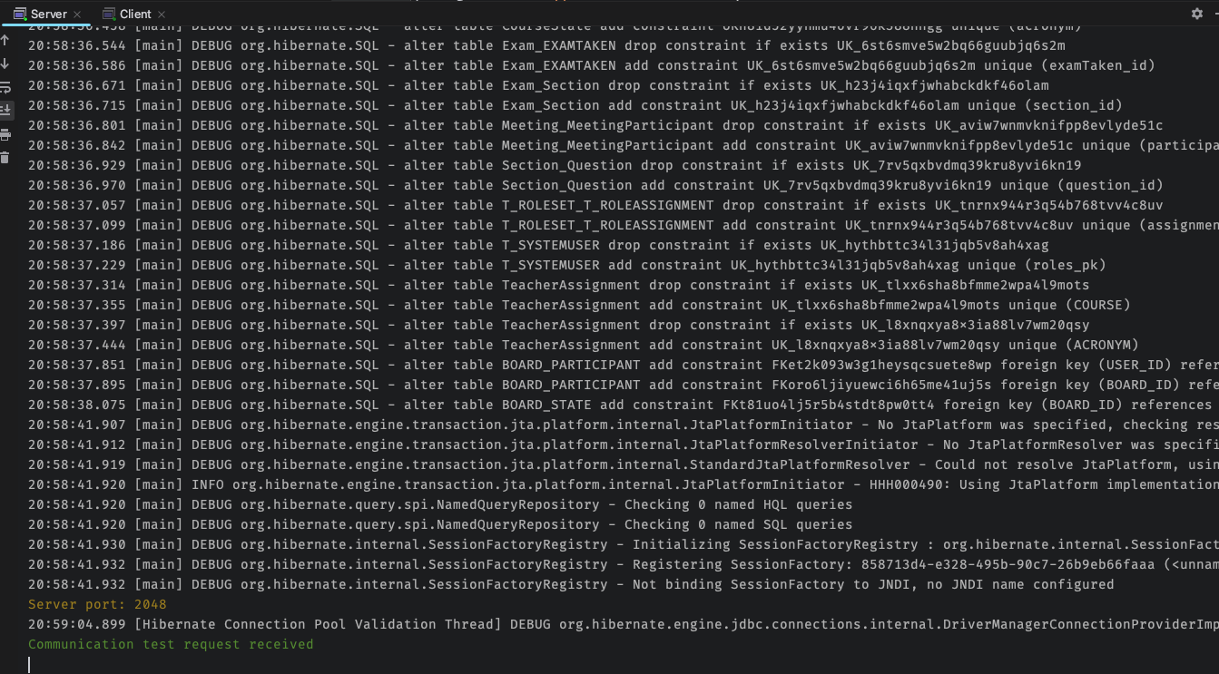
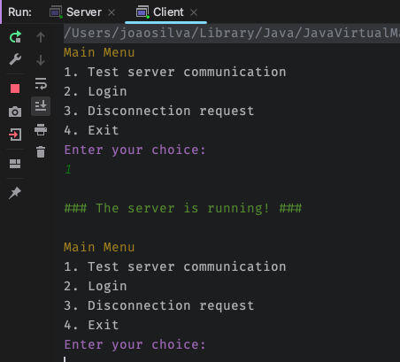
Sprint Review
RCOMP
Date: 18/06/2023
Demonstration:

Slide 12
Sprint Review
Date: 18/06/2023
Team development stages (Tuckman Stages):
The teams in the beginning of this last Sprint was already in the performing stage, and there were several task assigned that weren’t done in the previous sprint.
Unfortunately, there was a setback and one of the team members decided to leave the group without notice and thus the group was set once again to the storming state.
The norming stage only arrived in the last days of the product delivery.
With this setback the tasks that were, optimistically, assigned suffered a great delay and were most of them executed in the last days of delivery.

Slide 13
Sprint Review
Date: 18/06/2023
Main conclusions:
Each team member should have started earlier is work and with a more uniform pace in order to clear doubts and properly solve them on the respective task.
The team should have a better “know-how” of the technical aspects and challenges from the problems that each tasks presented to be solved.
Each member should split their tasks into smaller ones, in order to release dependencies to other members faster. This also helps with code reviews since the changes will be less per pull request.
The tasks should have been prioritized according to the main functionalities of the intended application and should only been assigned after the core functionalities have been finished.
There should have been a clearer communication protocol. That would permit the team to know if all the team members were all available or if there was some setback and the work should have to be reorganized.

Slide 14
Sprint Retrospective
Date: 18/06/2023
What went well?
Good interaction with GitHub.
Good team spirit.
Good team-work.
What went wrong?
Late resolution of the issues.
Lack of time to complete all tasks.
No time to study the technical aspects.
Late task review.
Lack of organization.
What we’ve learned?
The team members should have a stricter time-management.
The work should start from the beginning.
Team should allocate time to study the technical aspects involving an issue.
The review of each task should happen earlier to avoid errors.
We must have a well-established organization / time management.
The communication protocol should have been stricter.
We should prioritize the core tasks.

Slide 15
Sprint Retrospective
Date: 18/06/2023
Action items:
Earlier definition of the issues
Earlier attribution of the issues
Earlier definition of the tasks of each issue
Prioritize the tasks
More interaction between students/teachers to have more support
Create a routine for each day to study and develop some code for the pending issues

